Slide 1
B.Tech ECE Final Year Project - Final Review
RAINFALL PREDICTION USING FEATURE ENGINEERING TECHNIQUES
Presentation By:
18BEC0397
Satish Sarma
Project Guide:
Dr. Karthikeyan M
School of Electronics Engineering
VIT, Vellore
18BEC0389
Inturi Harshith
18BEC0951
Vanganur Madhusudhan

Slide 2
Current Status and Motivation
The current rainfall prediction systems are made to be one of the fastest procedures to predict rainfall distributions and screen floods, which use Internet of Things (IoT) systems to obtain data, combined with Machine Learning and Feature Engineering Techniques used for the estimation.
There exist many methods of early detection of floods, that use various models and prediction techniques to best estimate rainfall. However, they tend to be more time consuming, less efficient, and less effective than what is possible.
The Data analysis and Feature Engineering techniques carried out in our project are extremely effective in preparing the data to be clean and uniformly distributed, and the usage of a GPU in execution of our models shows the time efficiency of our system in comparison to standard CPU executions.

Slide 3
Literature Survey
Author | Year | Title | Aim | Method Used | Conclusion
Dai, Weijun & Tang, Yanni & Zhang, Zeyu & Cai, Zhiming | 2021 | Ensemble Learning Technology for Coastal Flood Forecasting in Internet of Things Enabled Smart City | To use an ensemble learning method based on BMC-EL to predict floods | BMC-EL, LR, LSVM, QSVM, BPNN and RF models, and their reliability comparison | BMC-EL model has the best prediction results, and the highest reliability
M. Shankar, T. J. John, S. Karthick, B. Pattanaik, M. Pattnaik and S. Karthikeyan | 2021 | Internet of Things based Smart Flood forecasting and Early Warning System | To demonstrate an effective flood detection and early warning system using Arduino and IoT Systems | An IoT multi-sensor system to measure real-time environmental variables via cloud and monitor data threshold levels | IoT system gives productive and precise detection information for observing and cautioning purposes
V P, Tharun & Prakash, Ramya & Subramanian, Renuga devi | 2018 | Prediction of Rainfall Using Data Mining Techniques | To predict rainfall via various Data mining techniques and machine learning models | Data Preprocessing, feeding into SVM, RF and DT regression models, and measuring performance of each | Best regression technique is RF with r-square value 0.981 and adjusted r-square value 0.980
Aswin S, Geetha P, Vinayakumar R | 2018 | Deep Learning Models for the Prediction of Rainfall | To obtain rainfall precipitation models using Deep Learning Architectures and their comparison | LSTM and ConvNet Deep Learning Architectures, and a comparison of their RMSE and MAPE Error values | Both architectures effective, ConvNet architecture showing lower RMSE values

Slide 4
Hardware and Software Details
The various softwares and hardware components used in our work are listed as follows:
Python - Primary programming language used.
Jupyter Notebooks - Primary programming software used.
Tableau - Software for visualization of maps of rainfall distributions and
cluster analysis.
GPU - Graphic processing unit used for comparison of execution times of the model with standard CPU execution times in a computer.

Slide 5
Objective
We aim to find and demonstrate the best fitting algorithm and the best techniques for prediction of rainfall with the help of Australian rainfall distribution data obtained from kaggle. We aim to show a comparison of various models used for such prediction, and conclude which model is most suitable for the work, by comparing the accuracies, errors and execution times of each
As weather conditions are not same for the entire nation, we also plan to cluster the locations based on GPS such that the weather conditions are similar in those particular clustered zones. Then we will attempt to find the best fitting algorithm for each zone, and evaluate the reliability and efficiency of each.

Slide 6
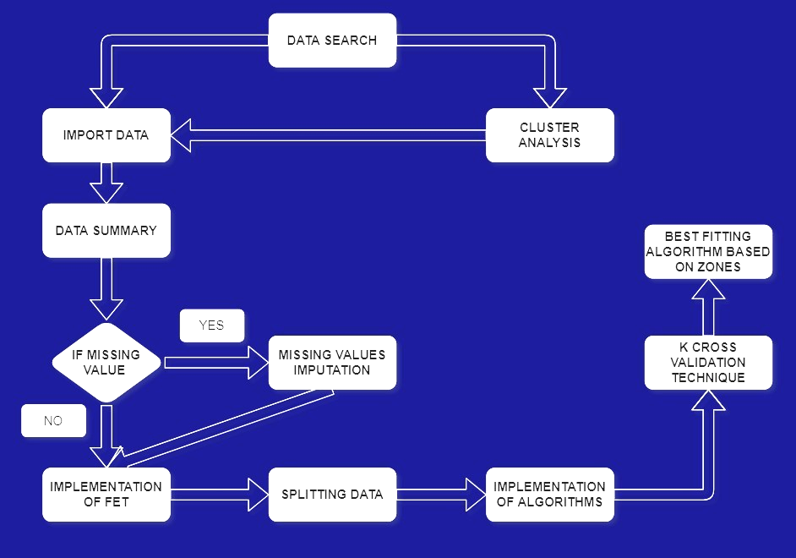
Methodology

Slide 7
Feature Engineering Techniques
In order to make machine learning work well on new tasks, it might be necessary to design and train better features obtained from the data in the dataset.
Some of the Feature Engineering techniques we use on our data are:
Missing Values Imputation by median
Categorical Values Imputation by mode
Data Normalization
Label Encoding
Resolving Multicollinearity Issues using VIF

Slide 8
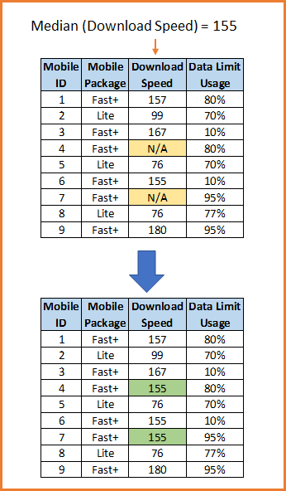
Missing values in the data are imputed via median or mode of the non missing values. An example of how this process works is illustrated below:

Slide 9
When multiple independent variables are highly correlated in the data, the effects of each variable on our target variable are hard to analyze. This is called multicollinearity, and can be resolved by keeping a highly correlated variable and dropping the others
we resolve this issue using Variable Inflation Factor (VIF) which is a number that shows the strength of correlation between the highly correlated variables. If two values are found to be highly correlated through the comparison of their VIFs, one of the two values can be removed from the data to resolve the multicollinearity.

Slide 10
The variables we used after dealing with the multicollinearity issue, and their respective VIF (Variable Inflation Factor) values are shown below:
S. No | Variable | VIF | S. No | Variable | VIF
1 | Location | 3.679918 | 8 | WindSpeed9am | 4.949934
2 | MinTemp | 5.741403 | 9 | WindSpeed3pm | 7.750609
3 | Evaporation | 4.848245 | 10 | Humidity3pm | 10.311760
4 | Sunshine | 7.816628 | 11 | Cloud9am | 8.091534
5 | WindGustDir | 6.167268 | 12 | Cloud3pm | 9.122193
6 | WindDir9am | 4.133418 | 13 | RainToday | 1.590356
7 | WindDir3pm | 5.967294 | 14 | RainTomorrow | 1.704695

Slide 11
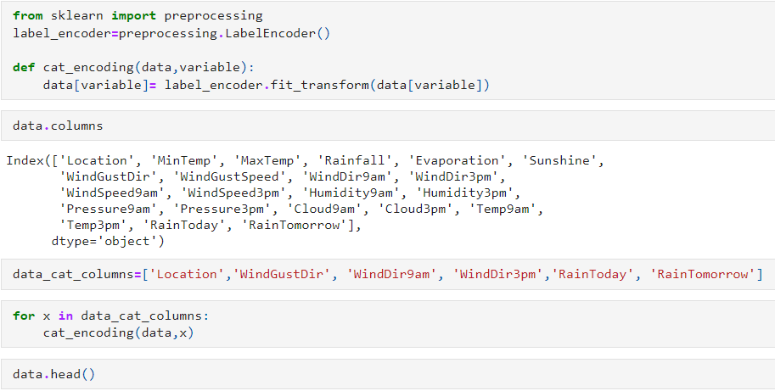
Labels of the categories are converted into sequential numbers, which is a more machine-readable format (Label Encoding):

Slide 12
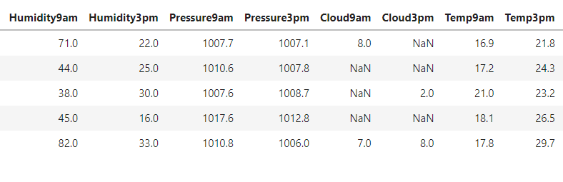
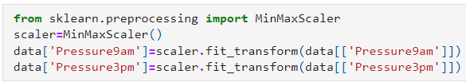
The data is also normalized to remove any extremely high scaled data categories that can skew the predictions. One of such values in our data is shown below:

Slide 13
Machine Learning Algorithms
After completion of our Data Analysis and Feature Engineering Techniques, we use the data to train the various machine learning algorithms listed below:
Linear Regression Algorithm
Random Forest Algorithm
XGBoost Algorithm
The execution of the algorithms is shown in the upcoming sections.

Slide 14
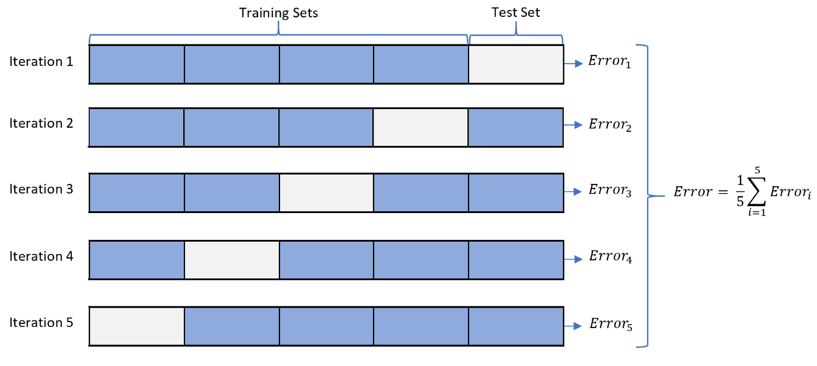
K-Cross Validation Technique
We test the effectiveness of our algorithms using this technique. The data is divided into ‘k’ folds, and one fold is considered for testing while the rest are considered for training. Multiple iterations of the training of the model are run, with different folds considered for testing in each iteration. An accuracy score is obtained for every iteration, and the arithmetic mean of the scores is considered as the overall accuracy:

Slide 15
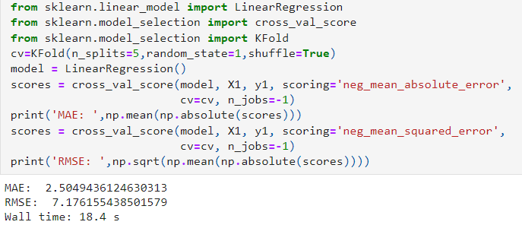
First, we train the Linear Regression Algorithm:

Slide 16
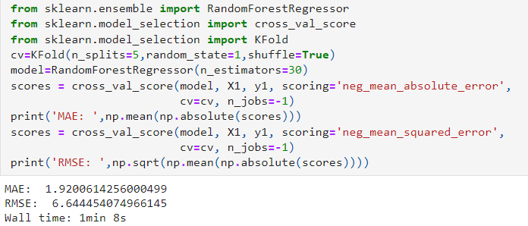
Next, we train the Random Forest Algorithm:

Slide 17
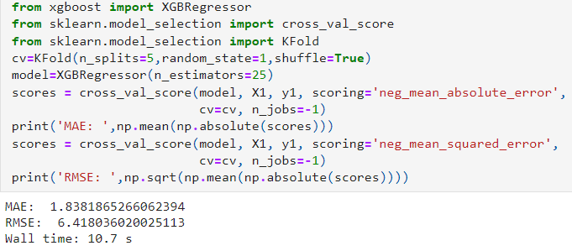
Finally, the XGBoost Algorithm:

Slide 18
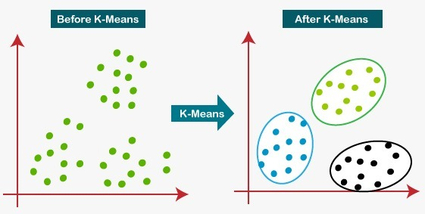
K-Means Clustering
K-Means Clustering is a type of unsupervised learning algorithm which is used with unlabeled data, by finding ‘k’ number of groups/clusters into which the data is divided, based on similar variables or factors among the data.

Slide 19
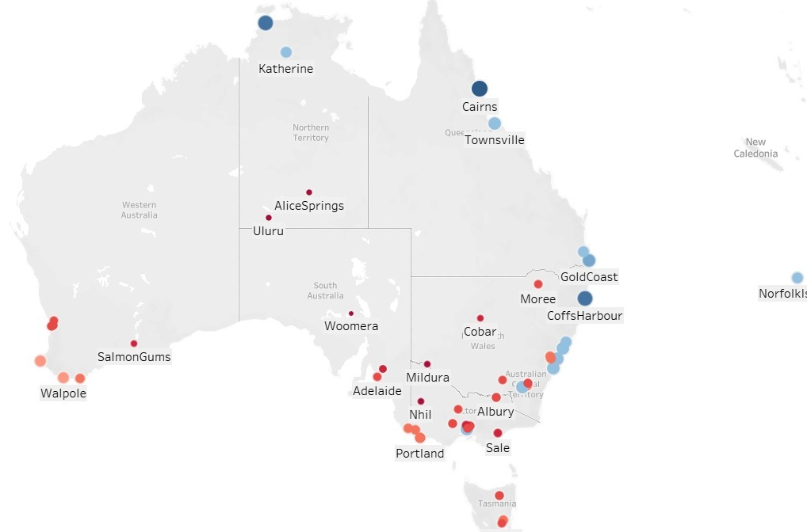
We use Tableau software to help in the visualization of the clustering process. We can observe the various locations in the country before the clustering, as follows:

Slide 20
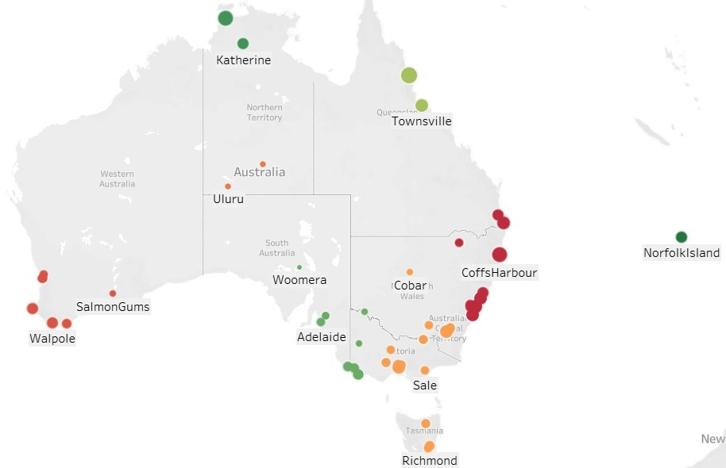
After Clustering, we can clearly observe the split of the seven zones from the tableau graph, which have been clustered based on geographical location. Each color represents a specific zone:

Slide 21
Results - Comparison of Metrics
After the execution of our algorithms, we have made a comparison of the measures listed below with regards to each algorithm, to determine the best algorithm suited for the dataset.
The various measures considered for comparison are:
Mean Absolute Error (MAE)
Root Mean Square Error (RMSE)
Execution Times (CPU vs GPU)

Slide 22
We observe the performance of the three algorithms on the complete processed data shown below. The table shows a comparison of the Mean Absolute Error (MAE), Root Mean Square Error (RMSE), and the CPU and GPU Execution Times of each of the algorithms:
Algorithm | Mean Absolute Error (MAE) | Root Mean Square Error (RMSE) | Execution Time (CPU) | Execution Time (GPU)
Linear Regression | 2.48502 | 7.239231 | 373ms | 171ms
Random Forest | 1.872458 | 6.589059 | 43.5s | 21.5s
XGBoost | 1.786853 | 6.393161 | 4.5s | 3.27s

Slide 23
We display below the values obtained from each of the three algorithms in our base reference paper, and a comparison of them with the values obtained in our work:
Algorithm | Mean Absolute Error (MAE) |  | Root Mean Square Error (RMSE)
 | Base Paper | Our Design | Base Paper | Our Design
Linear Regression | 4.97 | 2.485 | 8.61 | 7.239
Random Forest | 4.49 | 1.872 | 8.82 | 6.589
XGBoost | 3.58 | 1.787 | 7.85 | 6.393

Slide 24
Now we compare our obtained accuracy scores from each of the seven zones:
Zone 1
Algorithm | MAE | RMSE
LR | 3.36 | 9.16
RF | 2.84 | 9.32
XGBoost | 2.71 | 9.08
Zone 2
Algorithm | MAE | RMSE
LR | 1.74 | 4.35
RF | 1.52 | 4.34
XGBoost | 1.56 | 4.37
Zone 3
Algorithm | MAE | RMSE
LR | 1.06 | 3.67
RF | 0.73 | 3.52
XGBoost | 0.77 | 3.87
Zone 4
Algorithm | MAE | RMSE
LR | 1.87 | 3.71
RF | 1.57 | 3.62
XGBoost | 1.53 | 3.54

Slide 25
Zone 5
Algorithm | MAE | RMSE
LR | 6.15 | 14.21
RF | 3.73 | 12.23
XGBoost | 3.95 | 12.3
Zone 6
Algorithm | MAE | RMSE
LR | 1.41 | 3.71
RF | 1.13 | 3.62
XGBoost | 1.09 | 3.54
Zone 7
Algorithm | MAE | RMSE
LR | 5.09 | 12.41
RF | 3.01 | 10.21
XGBoost | 2.85 | 9.93
OVERALL
Algorithm | MAE | RMSE
LR | 2.5 | 7.17
RF | 1.92 | 6.64
XGBoost | 1.83 | 6.41

Slide 26
Conclusion
Our design for the prediction of rainfall has provided optimal results under most circumstances:
It has shown great improvement in accuracy scores in comparison to our reference paper.
The analysis of clusters has shown how our algorithms can perform when provided with different types of data in different distributions, and has shown that the XGBoost algorithm is most suitable for prediction overall.
It has proven to be more time efficient, highly reliable, and simple to understand and execute, and can therefore be used in real time to predict rainfall in a location.

Slide 27
Scope For Improvement
Our design has shown good reliability in prediction of rainfall. However, it is a fairly simple model which does not have much complexity and does not take much time to execute.
The model can be improved by working with Deep Learning Algorithms such as Convolutional Neural Networks, which provides higher accuracy scores as a tradeoff for more complexity and higher execution times.
Deep Learning models go through more epochs in the process of model training, which reduces the error by a sequential manner.

Slide 28
Project Timeline
Timeline | Progress
December 1st - January 1st | Completion of Literature Survey and Analysis of Current Research and Improvements
January 1st - February 1st | Learning and Implementing Preprocessing and Feature Engineering Techniques
February 1st - March 1st | Implementation of Machine Learning Algorithms and comparison of their performance measures
February 1st - March 1st | Research Paper and Project Completion
April 1st - May 1st | Completion of project and design of the final Project Report

Slide 29
References
Liyew, Chalachew & Melese, Haileyesus. (2021). Machine learning techniques to predict daily rainfall amount. Journal of Big Data. 8. 10.1186/s40537-021-00545-4.
Atitallah, S.B., et al.: Leveraging Deep Learning and IoT big data analytics to support the smart cities development: review and future directions. Comput. Sci. Rev. 38, 100303 (2020)
Dai, Weijun & Tang, Yanni & Zhang, Zeyu & Cai, Zhiming. (2021). Ensemble Learning Technology for Coastal Flood Forecasting in Internet-of-Things-Enabled Smart City. International Journal of Computational Intelligence Systems.14. 166. 10.1007/s44196-021-00023-y.
B. M. Shankar, T. J. John, S. Karthick, B. Pattanaik, M. Pattnaik and S. Karthikeyan, "Internet of Things based Smart Flood forecasting and Early Warning System," 2021 5th International Conference on Computing Methodologies and Communication (ICCMC), 2021, pp. 443-447, doi: 10.1109/ICCMC51019.2021.9418331.
Moussa, Moustafa & Zhang, Xiangliang & Claudel, Christian. (2016). Flash Flood Detection in Urban Cities Using Ultrasonic and Infrared Sensors. IEEE Sensors Journal. 16. 1-1. 10.1109/JSEN.2016.2592359.

Slide 30
Namitha K, Jayapriya A, Santhosh Kumar G. Rainfall prediction using artificial neural network on map-reduce framework. ACM. 2015. https://doi.org/10.1145/2791405.2791468.
Tharun VP, Prakash R, Devi SR. Prediction of Rainfall Using Data Mining Techniques. In 2018 Second International Conference on Inventive Communication and Computational Technologies (ICICCT). IEEE Xplore. 2018; pp. 1
Garg, Arnav & Pandey, Himanshu. (2019). Rainfall Prediction Using Machine Learning. 10.13140/RG.2.2.26691.04648.
Aswin S, Geetha P, Vinayakumar R. Deep learning models for the prediction of rainfall. In 2018 International Conference on Communication and Signal Processing (ICCSP). IEEE: New York. 2018; pp. 0657

Slide 31
Thank You

